Slide 1
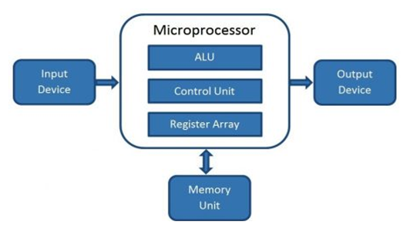
What is a Microprocessor?
Computer's Central Processing Unit (CPU) built on a single Integrated Circuit (IC) is called a microprocessor.
A digital computer with one microprocessor which acts as a CPU is called microcomputer.
It is a programmable, multipurpose, clock -driven, register-based electronic device that reads binary instructions from a storage device called memory, accepts binary data as input and processes data according to those instructions and provides results as output.
The microprocessor contains millions of tiny components like transistors, registers, and diodes that work together.
Block Diagram of a Microcomputer

Slide 2
A microprocessor consists of an ALU, control unit and register array. Where ALU performs arithmetic and logical operations on the data received from an input device or memory. Control unit controls the instructions and flow of data within the computer. And, register array consists of registers identified by letters like B, C, D, E, H, L, and accumulator.
Evolution of Microprocessors
First Generation (4 - bit Microprocessors)
The first generation microprocessors were introduced in the year 1971-1972 by Intel Corporation. It was named Intel 4004 since it was a 4-bit processor.
It was a processor on a single chip. It could perform simple arithmetic and logical operations such as addition, subtraction, Boolean OR and Boolean AND.
The control unit capable of performing control functions like fetching an instruction from storage memory, decoding it, and then generating control pulses to execute it.
Second Generation (8 - bit Microprocessor)
The second generation microprocessors were introduced in 1973 again by Intel. It was a first 8 - bit microprocessor which could perform arithmetic and logic operations on 8-bit words. It was Intel 8008 and 8085, and another improved version was Intel 8088.

Slide 3
Third Generation (16 - bit Microprocessor)
The third generation microprocessors, introduced in 1978 were represented by Intel's 8086, Zilog Z800 and 80286, which were 16 - bit processors with a performance like minicomputers.
Fourth Generation (32 - bit Microprocessors)
Several different companies introduced the 32-bit microprocessors, but the most popular one is the Intel 80386.
Fifth Generation (64 - bit Microprocessors)
From 1995 to now we are in the fifth generation. After 80856, Intel came out with a new processor namely Pentium processor followed by Pentium Pro CPU, which allows multiple CPUs in a single system to achieve multiprocessing.
Other improved 64-bit processors are Celeron, Dual, Quad, Octa Core processors.

Slide 4
Table: Important Intel Microprocessors
Microprocessor | Year of Invention | Word Length | Memory addressing Capacity | Pins | Clock | Remarks
4004 | 1971 | 4-bit | 1 KB | 16 | 750 KHz | First Microprocessor
8085 | 1976 | 8-bit | 64 KB | 40 | 3-6 MHz | Popular 8-bit Microprocessor
8086 | 1978 | 16-bit | 1MB | 40 | 5-8 MHz | Widely used in PC/XT
80286 | 1982 | 16-bit | 16MB real, 4 GB virtual | 68 | 6-12.5 MHz | Widely used in PC/AT
80386 | 1985 | 32-bit | 4GB real, 64TB virtual | 132 14X14 PGA | 20-33 MHz | Contains MMU on chip
80486 | 1989 | 32-bit | 4GB real, 64TB virtual | 168 17X17 PGA | 25-100 MHz | Contains MMU, cache and FPU, 1.2 million transistors

Slide 5
Table: Important Intel Microprocessors
Microprocessor | Year of Invention | Word Length | Memory addressing Capacity | Pins | Clock | Remarks
Pentium | 1993 | 32-bit | 4GB real,32-bit address,64-bit data bus | 237 PGA | 60-200 | Contains 2 ALUs,2 Caches, FPU, 3.3 Million transistors, 3.3 V, 7.5 million transistors
Pentium Pro | 1995 | 32-bit | 64GB real, 36-bit address bus | 387 PGA | 150-200 MHz | It is a data flow processor. It contains second level cache also,3.3 V
Pentium II | 1997 | 32-bit | - | - | 233-400 MHz | All features Pentium pro plus MMX technology,3.3 V, 7.5 million transistors
Pentium III | 1999 | 32-bit | 64GB | 370 PGA | 600-1.3 MHz | Improved version of Pentium II; 70 new SIMD instructions

Slide 6
Table: Important Intel Microprocessors
Microprocessor | Year of Invention | Word Length | Memory addressing Capacity | Pins | Clock | Remarks
Pentium 4 | 2000 | 32-bit | 64GB | 423 PGA | 600-1.3 GHz | Improved version of Pentium III
Itanium | 2001 | 64-bit | 64 address lines | 423 PGA | 733 MHz-1.3 GHz | 64-bit EPIC Processor
Where,
PGA - Pin Grid Array
MMX - Multi Media eXtensions
EPIC - Explicitly Parallel Instruction Computing
SIMD - Single Instruction Multiple Data
ALU - Arithmetic and Logic Unit
MMU - Memory Management Unit
FPU - Floating Point Unit
XT stands for eXtended Technology.

Slide 7
Basic Terms used in Microprocessor
Instruction Set - The group of commands that the microprocessor can understand is called Instruction set. It is an interface between hardware and software.
Bus - Set of conductors intended to transmit data, address or control information to different elements in a microprocessor. A microprocessor will have three types of buses, i.e., data bus, address bus, and control bus.
IPC (Instructions Per Cycle) - It is a measure of how many instructions a CPU is capable of executing in a single clock.
Clock Speed - It is the number of operations per second the processor can perform. It can be expressed in megahertz (MHz) or gigahertz (GHz). It is also called the Clock Rate.
Bandwidth - The number of bits processed in a single instruction is called Bandwidth.
Word Length - The number of bits the processor can process at a time is called the word length of the processor. 8-bit Microprocessor may process 8 -bit data at a time. The range of word length is from 4 bits to 64 bits depending upon the type of the microcomputer.
Data Types - The microprocessor supports multiple data type formats like binary, ASCII, signed and unsigned numbers.

Slide 8
Working of Microprocessor
The microprocessor follows a sequence to execute the instruction: Fetch, Decode, and then Execute.
Initially, the instructions are stored in the storage memory of the computer in sequential order. The microprocessor fetches those instructions from the stored area (memory), then decodes it and executes those instructions till STOP instruction is met. Then, it sends the result in binary form to the output port. Between these processes, the register stores the temporary data and ALU (Arithmetic and Logic Unit) performs the computing functions.

Slide 9
Features of Microprocessor
Low Cost - Due to integrated circuit technology microprocessors are available at very low cost. It will reduce the cost of a computer system.
High Speed - Due to the technology involved in it, the microprocessor can work at very high speed. It can execute millions of instructions per second.
Small Size - A microprocessor is fabricated in a very less footprint due to very large scale and ultra large scale integration technology. Because of this, the size of the computer system is reduced.
Versatile - The same chip can be used for several applications, therefore, microprocessors are versatile.
Low Power Consumption - Microprocessors are using metal oxide semiconductor technology, which consumes less power.
Less Heat Generation - Microprocessors uses semiconductor technology which will not emit much heat as compared to vacuum tube devices.
Reliable - Since microprocessors use semiconductor technology, therefore, the failure rate is very less. Hence it is very reliable.
Portable - Due to the small size and low power consumption microprocessors are portable.

Slide 10
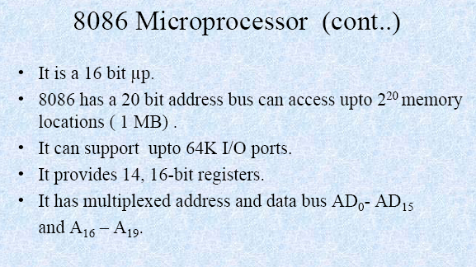
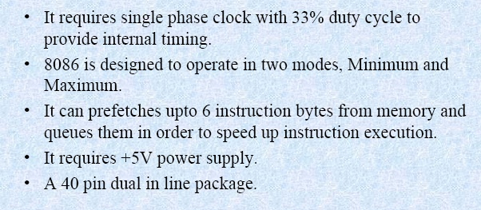
8086

Slide 11
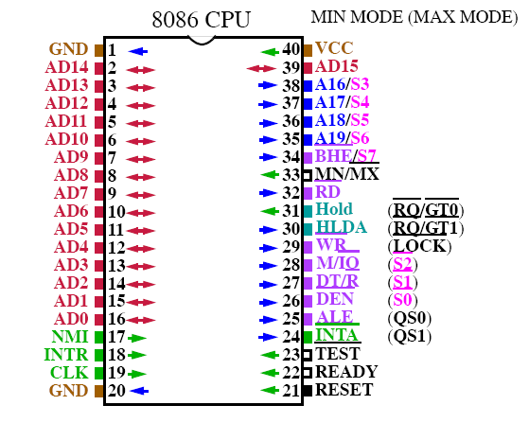
PIN DIAGRAM OF 8086

Slide 12
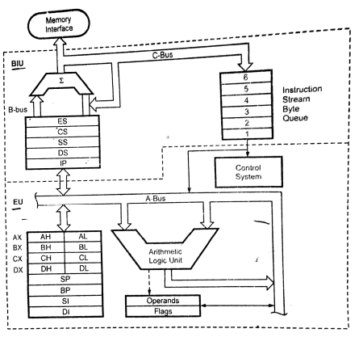
Block Diagram

Slide 13
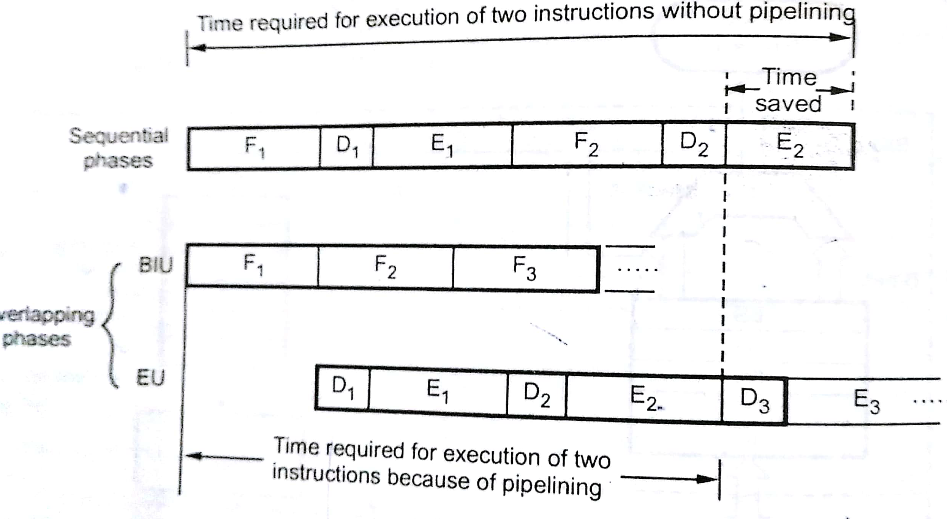
Pipelining

Slide 14
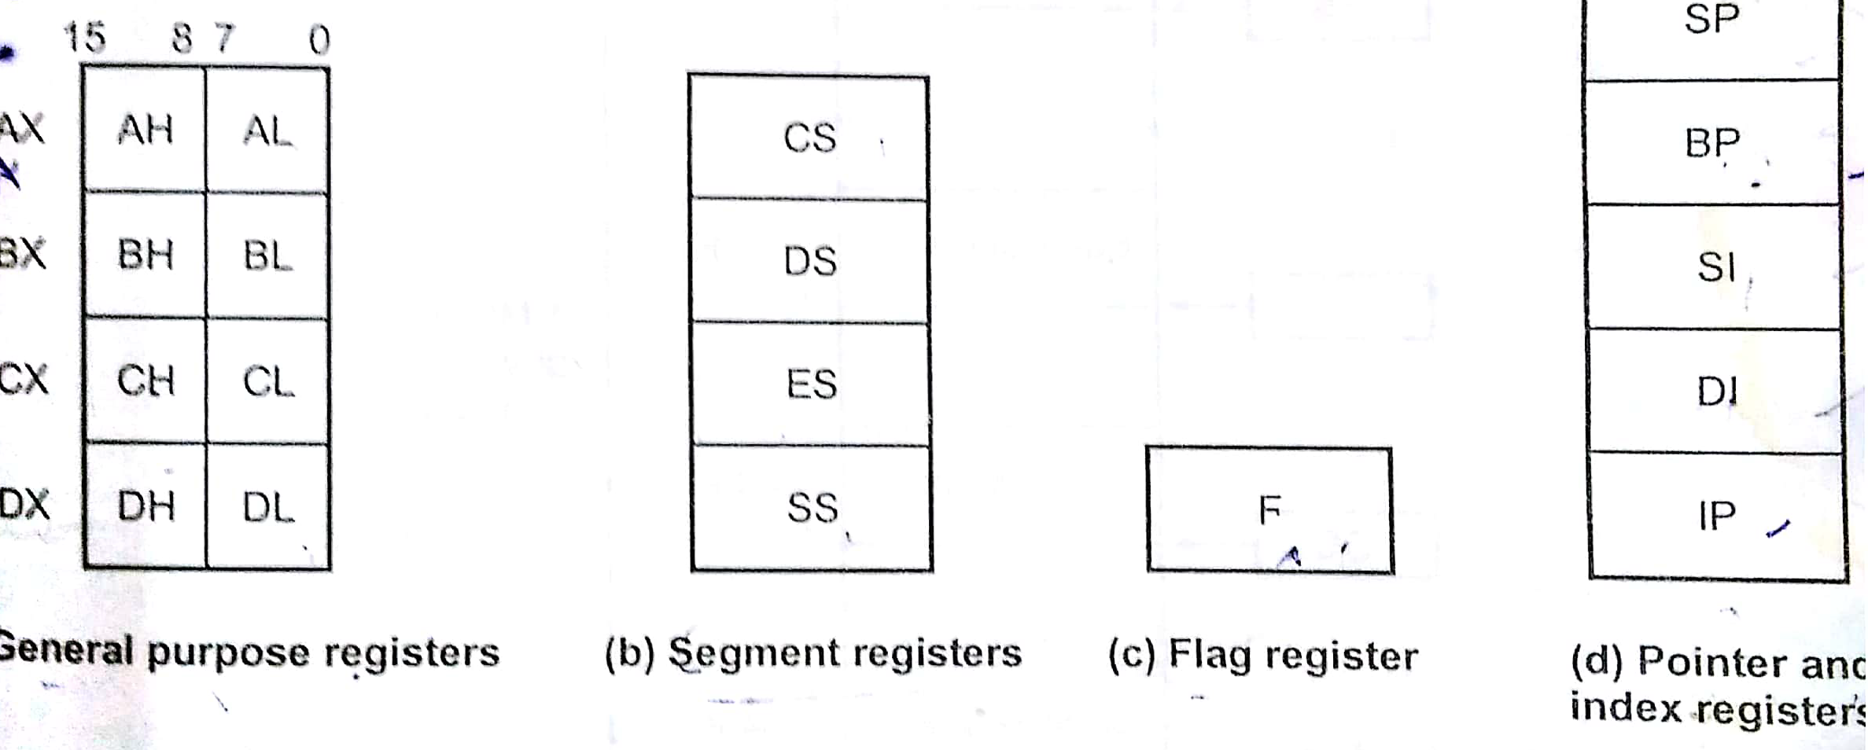
Register Organization

Slide 15
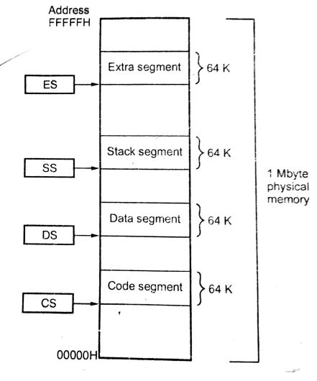
Segment Registers

Slide 16
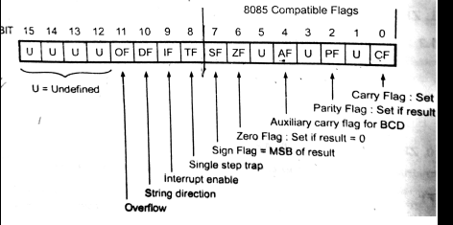
Flag Register

Slide 17
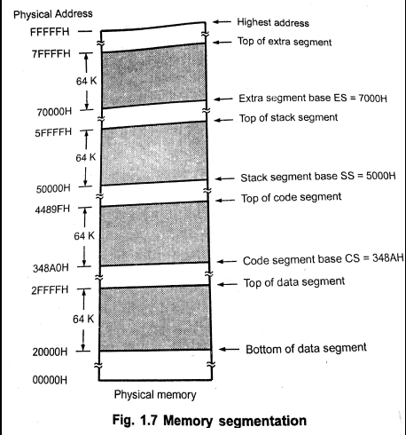
Segment Memory Organization

Slide 18
Instruction Set
Data transfer instructions
Arithmetic Instructions
Logical instructions
String instructions
Program control transfer instructions
Iterative control instructions
Processor control instructions

Slide 19
Addressing Modes
Direct Addressing Mode
Register Addressing Mode
Immediate Addressing Mode
Register Indirect Addressing Mode
Register Relative Addressing Mode
Base Indexed Addressing Mode
Register relative base indexed Addressing Mode

Slide 20
Assembler Directives
ALIGN instruction
ASSUME instruction
.CODE
.DATA
DATA TYPES
DUP
.END
MACRO AND END MACRO

Slide 21
1. DATA TRANSFER OPERATIONS
MOVE:
XOR AX, AX
MOV BL, AL
MOV CL, AL
MOV SI, 2000H
MOV CL, [SI]
MOV SI, 3000H
MOV DI, 4000H
L1: MOV AL, [SI]
MOV [DI], AL
INC SI
INC DI
LOOP L1
INT 3
XCHG:
XOR AX, AX
MOV BL, AL
MOV CL, AL
MOV SI, 2000H
MOV CL, [SI]
MOV SI, 3000H
MOV DI, 4000H
L1: MOV AL, [SI]
MOV BL, [DI]
XCHG AL, BL
MOV [SI], AL
MOV [DI], BL
INC SI
INC DI
LOOP L1
INT 3

Slide 22
ADDITION OPERATION
PROGRAM: ( 8 BIT ADDITION)
XOR AX, AX
MOV SI, 3000
MOV AL, [SI]
INC SI
MOV BL, [SI]
ADD AL, BL
INC SI
MOV [SI], AL
JC L1
INC SI
MOV [SI], AH
INT 3
L1: INC AH
INC SI
MOV [SI], AH
INT 3
b. PROGRAM: ( 16 BIT ADDITION)
XOR AX, AX
MOV DX, AX
MOV SI, 3000
MOV AX, [SI]
ADD SI, 02
MOV BX, [SI]
ADD AX, BX
ADD SI, 02
MOV [SI], AX
JC L1
ADD SI, 02
MOV [SI], DX
L1: INC DX
ADD SI, 02
MOV [SI], DX
INT 3

Slide 23
( Multi byte Addition)
ADDR | OPCODE | LABEL | MNEMONICS | OPERANDS | COMMENTS
2000 | BE 00 30 |  | MOV | SI, 3000H | ; Initialize SI to 3000H
2003 | BF 06 30 |  | MOV | DI, 3006H | ; Initialize DI to 3006H
2006 | BB 50 20 |  | MOV | BX, 2050H | ; Initialize BX to 2050H
2009 | 31 C0 |  | XOR | AX, AX | ; Clear the register AX
200B | 89 C1 |  | MOV | CX, AX | ; Move Accumulator contents to CX
200D | B1 08 |  | MOV | CL, 06H | ; Load the count register
200F | 8A 04 | L1: | MOV | AL, [SI] | ; Moving SI contents to Accumulator
2011 | 12 05 |  | ADC | AL, [DI] | ; Add contents of DI to and store in
2013 | 88 07 |  | MOV | [BX], AL | ; Move Accumulator contents to BX
2015 | 46 |  | INC | SI | ; Increment Source Index
2016 | 47 |  | INC | DI | ; Increment Destination Index
2017 | 43 |  | INC | BX | ; Increment BX register
2018 | FE C9 |  | DEC | CL | ; Decrement CL register
201A | 75 F3 |  | JNZ | L1 | ; If not zero jump L1
201C | 73 02 |  | JNC | L2 | ; If no carry jump L2
201E | FE C4 |  | INC | AH | ; If carry increment AH register
2020 | 88 27 | L2: | MOV | [BX], AH | ; Move contents of AH to address location in BX
2022 | CC |  | INT | 3 | ; Breaking program

Slide 24
MULTI PLICATION OPERATION
MULTIPLICATION (UNSIGNED)
ADDR | OPCODE | LABEL | MNEMONICS | OPERANDS | COMMENTS
 | A1 00 25 |  | XOR MOV MOV | AX, AX DX, AX AX, [2500H] | ; Moving contents of 2500h to acc.
 | 8B 1E 02 25 |  | MOV | BX, [2502H] | ; Moving contents 2502H to BX
 | F7 E3 |  | MUL | BX | ; Multiply AX with contents of BX & result in AX,DX
2009 | A3 50 20 |  | MOV | [2050H], AX | ; Move contents of AX is to store in 2050 location
200C | 89 16 52 20 |  | MOV | [2052H], DX | ; Move contents of DX is store in 2052 location
2010 | CC |  | INT | 3 | ; Breaking Interrupt
INPUT | OUTPUT
[2500] = 0FF | [2050] = 01
[2501] = 0FF | [2051] = 00
 | [2052] = 0FE
[2502] = 0FF | [2053] = 0FF
[2503] = 0FF

Slide 25
MULTI PLICATION OPERATION
MULTIPLICATION (SIGNED)
ADDR | OPCODE | LABEL | MNEMONICS | OPERANDS | COMMENTS
 | A1 00 25 |  | XOR MOV MOV | AX, AX DX, AX AX, [2500H] | ; Moving contents of 2500h to accumulator
 | 8B 1E 02 25 |  | MOV | BX, [2502H] | ; Moving contents 2502H to BX
 | F7 EB |  | IMUL | BX | ; Signed multiplication of contents AX & BX
 | A3 50 20 |  | MOV | [2050H], AX | ; Move contents of AX is to store in 2050 location
 | 89 16 52 20 |  | MOV | [2052H], DX | ; Move contents of DX is store in 2052 location
 | CC |  | INT | 3 | ; Breaking Interrupt
INPUT | OUTPUT
[2500] = 0FE | [2050] = 0F2
[2501] = 0FF | [2051] = 0FF
 | [2052] = 0FF
[2502] = 07 | [2053] = 0FF
[2503] = 00

Slide 26
ROTATE
ADDR | OPCODE | LABEL | MNEMONICS | OPERANDS | COMMENTS
2000 | A1 00 25 |  | MOV | AX, [2500H] | ; Moving contents of 2500h to accumulator
2003 | B1 04 |  | MOV | CL, 04 | ; Moving contents to Count register
2005 | D3 C0 |  | ROL / ROR | AX, CL | ; Rotate left the contents of accumulator by 4 times
2007 | A3 50 20 |  | MOV | [2050H], AX | ; Move contents of AX is to store in 2050 location
200A | CC |  | INT | 3 | ; Breaking Interrupt
SHIFT
ADDR | OPCODE | LABEL | MNEMONICS | OPERANDS | COMMENTS
2000 | A1 00 25 |  | MOV | AX, [2500H] | ; Moving contents of 2500h to accumulator
2003 | B1 04 |  | MOV | CL, 04 | ; Moving contents to Count register
2005 | D3 E0/D3E8 |  | SHL/SHR | AX, CL | ; Rotate left the contents of accumulator by 4 times
2007 | A3 50 20 |  | MOV | [2050H], AX | ; Move contents of AX is to store in 2050 location
200A | CC |  | INT | 3 | ; Breaking Interrupt

Slide 27
ADDITION OF TWO ASCII NUMBERS
ADDR | OPCODE | LABEL | MNEMONICS | OPERANDS | COMMENTS
2000 | B4 00 |  | MOV | AH, 00H | ; Clear accumulator
2002 | A0 00 25 |  | MOV | AL, [2500H] | ; Load contents of 2500h to
2005 | 8B 1E 01 25 |  | MOV | BL, [2501H] | ; Loading contents 2501H to BL
2009 | 00 D8 |  | ADD | AL, BL | ; Add contents of BL to and store result in
200B | 37 |  | AAA |  | ; ASCII adjustment after addition
200C | A3 50 20 |  | MOV | [2050H], AX | ; Store result in AX in to 2050 location
200F | CC |  | INT | 3 | ; Breaking Interrupt
INPUT | OUTPUT
[2500] = 37 | [2050] = 02
 | [2051] = 01
[2501] = 35

Slide 28
DECIMAL OPERATIONS
DAA:
DAS:
XOR AX, AX
MOV BL,AL
MOV SI, 3000H
MOV AL, [SI]
INC SI
MOV BL, [SI]
ADD AL,BL
MOV SI, 5000H
MOV [SI], AL
DAA
INC SI
MOV [SI], AL
INT 3
XOR AX, AX
MOV BL,AL
MOV SI, 3000H
MOV AL, [SI]
INC SI
MOV BL, [SI]
SUB AL,BL
MOV SI, 5000H
MOV [SI], AL
DAS
INC SI
MOV [SI], AL
INT 3

Slide 29
PACKED BCD TO UNPACKED BCD
ADDR | OPCODE | LABEL | MNEMONICS | OPERANDS | COMMENTS
2000 | A0 50 20 |  | MOV | AL, [2050H] | ; Move 2050h contents to
2003 | 88 C3 |  | MOV |  | ; Move contents to BL
2005 | 80 E3 F0 |  | AND | BL, 0F0H | ; AND BL contents with 0F0 and store result in BL
2008 | B1 04 |  | MOV | CL, 04H | ; Load count register with 04h
200A | D2 CB |  | ROR | BL, CL | ; Rotate right BL by 04h times
200C | 88 1E 60 20 |  | MOV | [2060H], BL | ; Moving contents of BL to 2060H
2010 | 24 0F |  | AND | AL, 0FH | ; AND with 0FH and store result in
2012 | A2 61 20 |  | MOV | [2061H], AL | ; Moving contents of to 2061H
2015 | CC |  | INT | 3 | ; Breaking interrupt

Slide 30
(un packed to packed)
XOR AL, AL
MOV SI, 3000
MOV AL, [SI]
INC SI
MOV BL, [SI]
MOV CL, 04
ROR BL, CL
ADD AL, BL
INC SI
MOV [SI], AL
INT 3
RESULT:
INPUT OUTPUT
[3000] = 09 [3002] = 59
[3001] = 05

Slide 31
SORTING
DATA SEGMENT
COUNT EQU 2000H
ADDR EQU 2500H
DATA ENDS
CODE SEGMENT
ASSUME CS:CODE,DS:DATA
START: MOV AX,DATA
MOV DS,AX
MOV SI,COUNT
MOV BL,[SI]
DEC BL
L3: MOV CL,BL
MOV SI,ADDR
L2: MOV AL,[SI]
CMP AL,[SI+1]
JLE L1
XCHG [SI+1],AL
MOV [SI],AL
L1: INC SI
LOOP L2
DEC BL
JNZ L3
INT 3
CODE ENDS
END START
INPUT: 2500: 05H (NUMBER OF ELEMENTS)
2501: 9A
2502: 08
2503: 93
2504: 34
2505: 01
OUTPUT: 2501: 01
2502: 08
2503: 34
2504: 93
2505: 9A

Slide 32
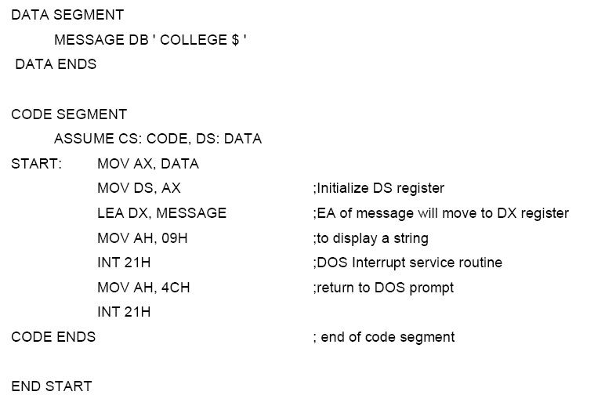
DISPLAY STRING ON THE MONITOR

Slide 33
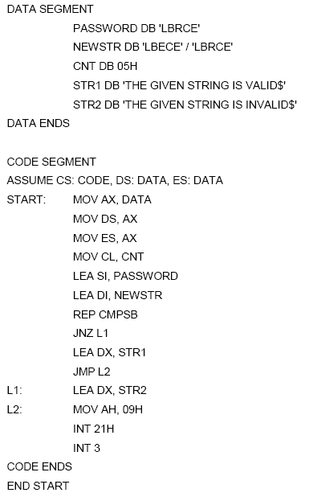
STRING COMPARISION

Slide 34
Y=X²+2X+5
CODE SEGMENT
ASSUME CS:CODE
START: XOR AX,AX
MOV BL,AL
MOV DX,AX
MOV SI,2000H
MOV AL,[SI]
MOV BL,AL
MUL BL
MOV DX,AX
MOV AL,02H
MUL BL
ADD AX,DX
ADD AX,05H
INC SI
MOV [SI],AX
INT 3
CODE ENDS
END START

Slide 35
Factorial of a given number
CODE SEGMENT
ASSUME CS:CODE
START: XOR AX,AX
XOR DX,AX
MOV BX,AX
MOV SI,2000H
MOV BL,[SI]
MOV AL,01H
L1: MUL BL
DEC BL
JNZ L1
MOV SI,3000H
MOV [SI],AX
INT 3
CODE ENDS
END START

Slide 36
Addition of 3*3 matrices
CODE SEGMENT
ASSUME CS:CODE
START: XOR AX,AX
XOR DX,AX
MOV BX,AX
MOV SI,2000H
MOV DI,3000H
MOV BX,4000H
MOV CL,09H
L1:MOV AL,[SI]
ADD AL,[DI]
MOV [BX],AL
INC SI
INC DI
INC BX
LOOP L1
INT 3
CODE ENDS
END START

Slide 37
Multiplication of two 3* 3 matrices
CODE SEGMENT
ASSUME CS:CODE
START: XOR AX,AX
MOV BX,AX
MOV CX,AX
MOV DX,AX
MOV BP,AX
MOV SI,2000H
MOV BP,3000H
MOV DI,4000H
MOV CL,03H
MOV CH,03H
L3: MOV BH,CH
L2:MOV DH,CH
MOV DL,00H
L1:MOV AL,[SI]
MOV BL,[BP]
MUL BL
ADD DL,AL
INC SI
ADD BP,03H
DEC DH
JNZ L1
MOV [DI],DL
INC DI
SUB SI,03H
SUB BP,09H
INC BP
DEC BH
JNZ L2
ADD SI,03H
MOV BP,3000H
DEC CL
JNZ L3
INT 3
CODE ENDS
END START

Slide 38
BCD to Binary (or) BCD to Hexa
CODE SEGMENT
ASSUME CS:CODE
START: XOR AX,AX
MOV BX,AX
MOV CX,AX
MOV DX,AX
MOV SI,3000H
MOV DL,[SI]
MOV DH,DL
AND DL,0FH
AND DH,0F0H
MOV CL,04H
ROR DH,CL
MOV AL,DH
MOV BL,0AH
MUL AL
ADD AL,DL
MOV DI,3000H
MOV [DI],AL
INT 3
CODE ENDS
END START
[2000H] – 75₁₀
[3000H] – 4B_{H}

Slide 39
BCD to Binary (or) BCD to Hexa
CODE SEGMENT
ASSUME CS:CODE
START: XOR AX,AX
MOV BX,AX
MOV CX,AX
MOV DX,AX
MOV SI,3000H
MOV DL,[SI]
MOV DH,DL
AND DL,0FH
AND DH,0F0H
MOV CL,04H
ROR DH,CL
MOV AL,DH
MOV BL,0AH
MUL AL
ADD AL,DL
MOV DI,3000H
MOV [DI],AL
INT 3
CODE ENDS
END START
[2000H] – 75₁₀
[3000H] – 4B_{H}

